Slide 1
CST-235 Computer Programming III
Topic 6 (2 weeks)

Slide 2
Lectures for Topic 6
Lectures:
Security Technologies: Week 1
Project Presentations: Week 2
Hands On:
Integrate Form Based Authentication into an Application.

Slide 3
Lectures for Topic 6 – Week 1
Lectures:
Topic 6 Project Assignment Requirements.
Security Technologies
Hands On:
Integrate Form Based Authentication into our ICA.

Slide 4
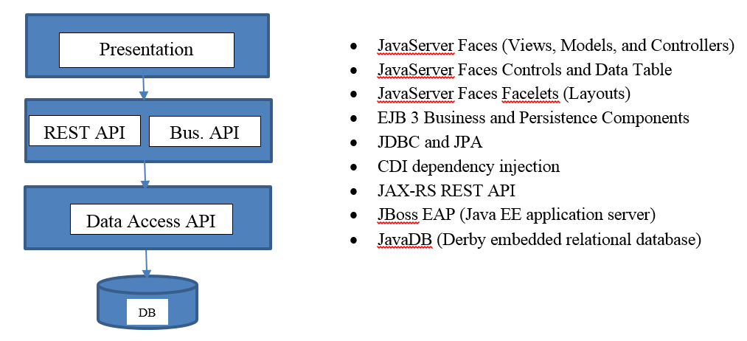
Project Overview
In this class you will design and build a complete enterprise class N-Layer application using Enterprise Java technologies, that meets a certain set of functional and technical requirements, and as shown in the figure below.
The Class Project has changed!

Slide 5
Review Topic 6 Assignment Requirements
Please pull up the Assignment #6 from the Announcement
Review the Requirements
NOTE: the requirement to secure your application using Java EE Security and Forms Based Authentication is OUT OF SCOPE.
The Class Project has changed. Please pull up the Project Requirements from the Assignment.

Slide 6
Introduction to Security in Enterprise Java

Slide 7
Discussion: What do I secure?
What might you have to secure in an Enterprise Java web application?
Web Application Access – Who and what role?
Database Access – Who can log in?
Services Access – Who and what role?
Data In Flight – What is that?
Data At Rest – What is that?

Slide 8

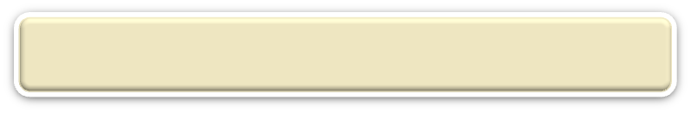

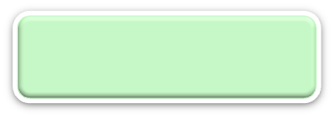


N-Layer Architecture
RIA Design
Client Layer (Desktop/Mobile/Browser)
User Interface, (Minimal) Client Side Validation, AJAX, UI Rules
AJAX
jQuery
CSS
Need to possibly secure data being transmitted from browser to the server
Forms
HTTP/HTTPS POST
We need to protect our application and services from being accessed by users who do not have those permissions!
Event Based Design
Presentation Layer (PL)
User Interface, UI Event Handlers, UI Rules, Navigation
JSF
Data Validators
Canonical Object Model
Local POJO, SOAP, REST
Design By Contract
Business/Services Layer (BLL)
Business Logic, Business Rules, Workflow, Data Validation
EJB
IoC/CDI
JAX-WS and JAX-RS
JMS
Canonical Object Model
Canonical Object Model
Optional SOAP, REST
SOAP, REST
Entity Driven Design
Data Access/Services Layer (DAL)
CRUD Data Persistence
Integration Tier
Orchestration
(Workflow*, Rules*)
Entity Beans (ORM)
Hibernate
JDBC
Data Access Objects
Need to possibly secure data being transmitted to other systems
Data Model
JMS, SOAP, REST, JAXB, Spring
Cache
Need to possibly secure data in the database
Operational
Database
External Systems
Interfaces, Feeds, Printers
Business Entity
Media
And you need to write SECURE CODE!

Slide 9
What is Authentication?
Authentication is the process of determining whether someone or something is, in fact, who or what it is declared to be usually (but not always) based on a username and password.
Authentication can be achieved with a single factor (like a username and password) as well as a two/multiple factors (like a username, password plus a pin or token).
Which of these is the least secure? Which of these is the most secure?

Slide 10
What is Authorization?
Authorization is the process of giving someone permission to do or have something. In web applications, usually an “administrator” defines for the system which users are allowed access to the system and what privileges of use. This is often based on roles that you define.
Privileges can be at a number of levels: app, pages, page, or widget.

Slide 11
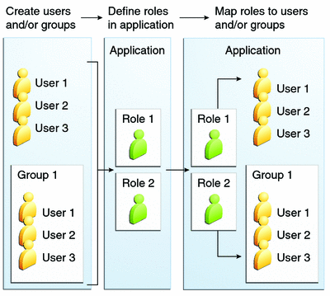
What are some other security terms used?
A realm is a security policy domain defined for a web or application server. A realm contains a collection of users, who may or may not be assigned to a group.
A user is an individual or application program identity that has been defined to access a web application.
A group is a set of authenticated users.
A role is an abstract name for the permission to access a particular set of resources in a web application.

Slide 12
Does Enterprise Java have a Security Framework?
YES!
Enterprise Java has had a built in Security Framework for a long time.
Application Servers provide hooks to leverage this Security Framework.
One of the common security problems to solve is how do secure my Web Application written using Enterprise Java technologies?
You can use Form Based Authentication in Java EE.
You can configure your Application Server to authenticate your users via a number of different sources for credentials (i.e. username and password):
Files
Database
LDAP Servers

Slide 13

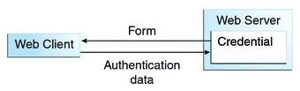
What are protected and unprotected resources?
Client – Server Programming
The first step in securing your application is identifying what pages you want protected that would first require a user to authenticate themselves.
This is configured in your web.xml file.
If a user tries to access a protected resource that is not authenticated we want a Login Form page to be displayed.

Slide 14
How do I create a Login Page?
Client – Server Programming
The second step in securing your application is to build the Login Form and Login Error pages.
Remember we are using a Security Framework.
We have to build a Login Form and Login Error page that conforms to the Java EE standard.
These should be unprotected pages!
These are configured in your web.xml file.

Slide 15
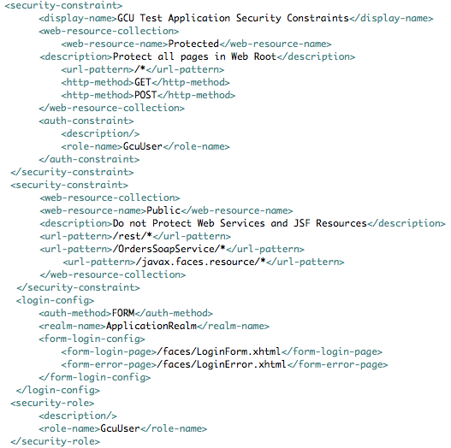
Can I see an example web.xml?
Security Constraint Definition
Rules to restrict access to resources under Web Root for GET and POST requests
Rules to restrict access to for all Users in the GcuUser role
Security Constraint Definition
Rules to with no restrictions to access to resources under /rest/ and any CSS/JS files, no auth-constraint so these are public resources that will not require authentication
The Login Form page and Login Error page
Security Role Definition

Slide 16
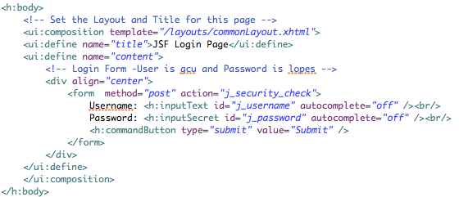
Can I see an example Login Form Page?
Must POST to this action
Must be a standard HTML Form
Must use these form ID’s
Remember, we are working with a Security Framework, so must conform to their standard!

Slide 17
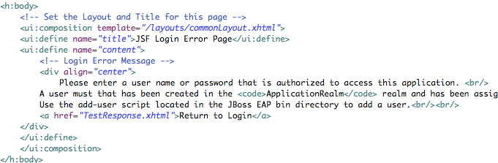
Can I see an example Login Error Page?
Can be any standard HTML or JSF page!
Remember, we are working with a Security Framework, so must conform to their standard!

Slide 18
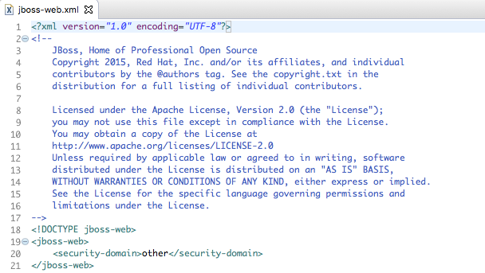
Is there any JBoss Configuration?
Any JBoss Specific configuration goes in this file
We tell JBoss what security domain to use for this web application
Default Security Domain define in JBoss standalone.xml

Slide 19
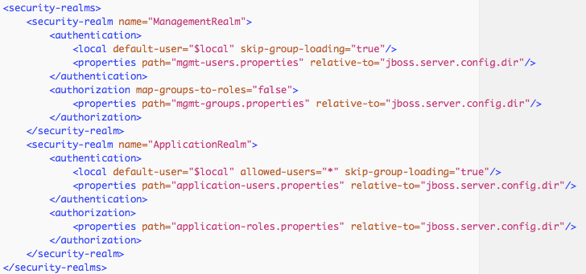
How do we tell JBoss how to Authenticate?
web.xml
JBoss standalone.xml
Simple file based list of Users and Roles

Slide 20

How can I force the Login Page at the start?
web.xml
You can simply set your default web page to a secure page!
This is configured in your web.xml file.
A Secure Page!

Slide 21
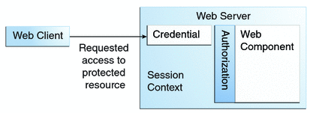
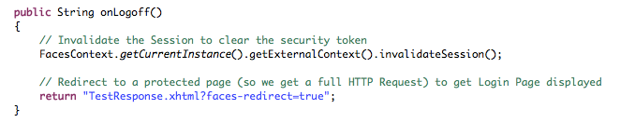
How do I Log Out of an application?
Client – Server Programming
When you are authenticated a Security Token or Principal is saved in the HTTP Session.
To log out simply invalidate/clear the HTTP Session and navigate to a secure page (which will send you to the Login page).

Slide 22
How do add Users to JBoss?
The third step in securing your application is to add some users to JBoss’s credential store (a property file):
Navigate to the bin directory where JBoss EAP is installed.
Locate the add-user script.
Run the add-user script (for Mac or Linux users you may need to run chmod 777 over the file to make it executable).
When prompted select the Application User type of user, enter a desired username (gcu), enter a desired password (lopes), enter GcuUser for the group, and answer no for connection to another process.
This will create a username and password you can now log into the assignment application. NOTE: the users are created in a file application-users.properties located in the JBoss EAP standalone/configuration directory.

Slide 23
In-Class Activity
Secure a Web Application using Java EE Security!
Complete the In-Class Activity #6a that I posted in an Announcement.

Slide 24
In-Class Activity
Work on Project!
Spend this time to work on your final Milestone Assignment.
NOTE: the requirement to secure your application using Java EE Security and Forms Based Authentication is OUT OF SCOPE.
Clean up and finish Design Report.
Create JavaDoc for your entire Project.
Execute your Test Plan.
Complete Project Presentation and prepare for Demo.

Slide 25
Lectures for Topic 5 – Week 2
Lectures:
Class Retrospective
Project Presentations
Hands On:
None.

Slide 26
A Look Back – Class Retrospective
RIA Design
Client Layer (Desktop/Mobile/Browser)
User Interface, (Minimal) Client Side Validation, AJAX, UI Rules
Java EE Tooling
AJAX
jQuery
CSS
ICA 1: JBoss IDE
ICA 1: JBoss AS
ICA 4: Derby DB
Forms
HTTP/HTTPS POST
Design Patterns
Event Based Design
Presentation Layer (PL)
User Interface, UI Event Handlers, UI Rules, Navigation
MVC DAO
DI/IoC
JSF
Data Validators
Canonical Object Model
Local POJO, SOAP, REST
Design By Contract
Business/Services Layer (BLL)
Business Logic, Business Rules, Workflow, Data Validation
Java EE Foundation
EJB
IoC/CDI
JAX-WS and JAX-RS
JMS
ICA 2: Servlets and JSP
ICA 2: JSF
ICA 3: EJB and CDI
ICA 4: JDBC
ICA 5: JAX-RS and JAX-WS
ICA 5: MDB
ICA 6: Security
Canonical Object Model
Canonical Object Model
Optional SOAP, REST
SOAP, REST
Entity Driven Design
Data Access/Services Layer (DAL)
CRUD Data Persistence
Integration Tier
Orchestration
(Workflow*, Rules*)
Entity Beans (ORM)
Hibernate
JDBC
Data Access Objects
Data Model
JMS, SOAP, REST, JAXB, Spring
Cache
Operational
Database
External Systems
Interfaces, Feeds, Printers
Business Entity
Media
What worked well? What needs to change? Stop…Start….Continue

Slide 27
Project Presentations

Slide 28
Weekend Reminders
Submit Milestone #6.
Final Design Report
Submit code
Submit project presentation
Submit screencast

